Slide 1
LIFE EXPECTANCY PREDICTION
BY
Umar uf247
Drishti DM4675
Arvind vav263

Slide 2
OBJECTIVE
In our project we aim to predict Life expectancy to compare it to human index development and alcohol consumption. This will help people to increase the measures to increase the life of people.
Several factors were taken into concentration to predict the life expectancy like GDP, population, income, expenditure etc

Slide 3
Dataset used
https://www.kaggle.com/kumarajarshi/life-expectancy-who

Slide 4
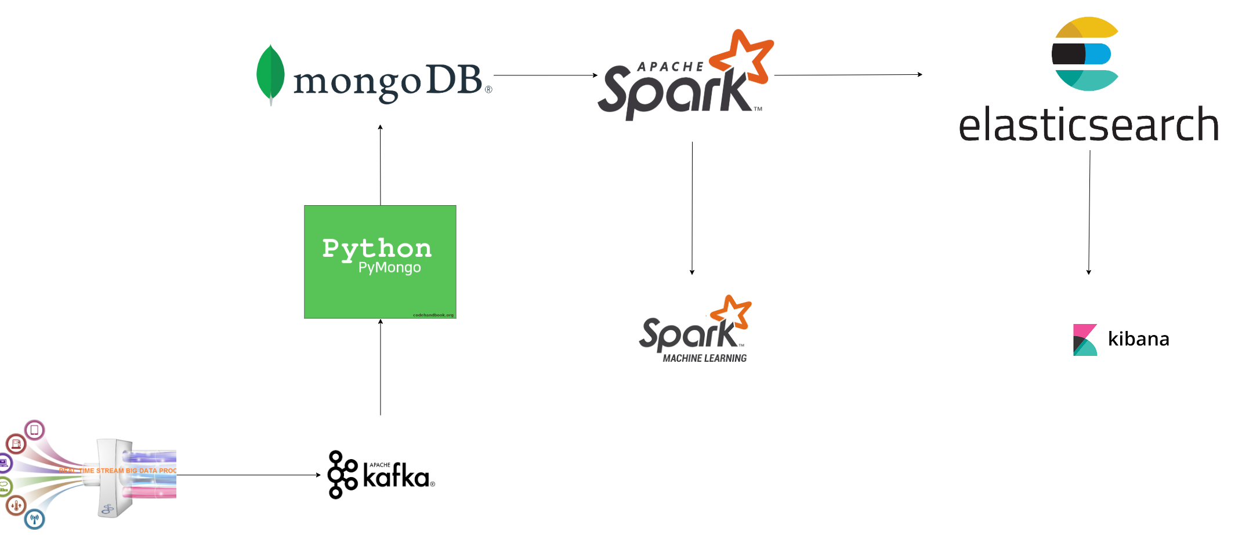
Tech Stack used

Slide 5
Data is streamed through Kafka
Python pymongo is used for data streaming which is stored in mongoDB which is no SQL database
Data is picked from MongoDB to Apache spark which uses Spark ML to predict life expectancy .
Data is cleaned and transformed using Apache Spark
Using Linear Regression we are able to generate result of root mean value of x:y
Data is persisted to elasticsearch which is used by Kibana for visualisation

Slide 6
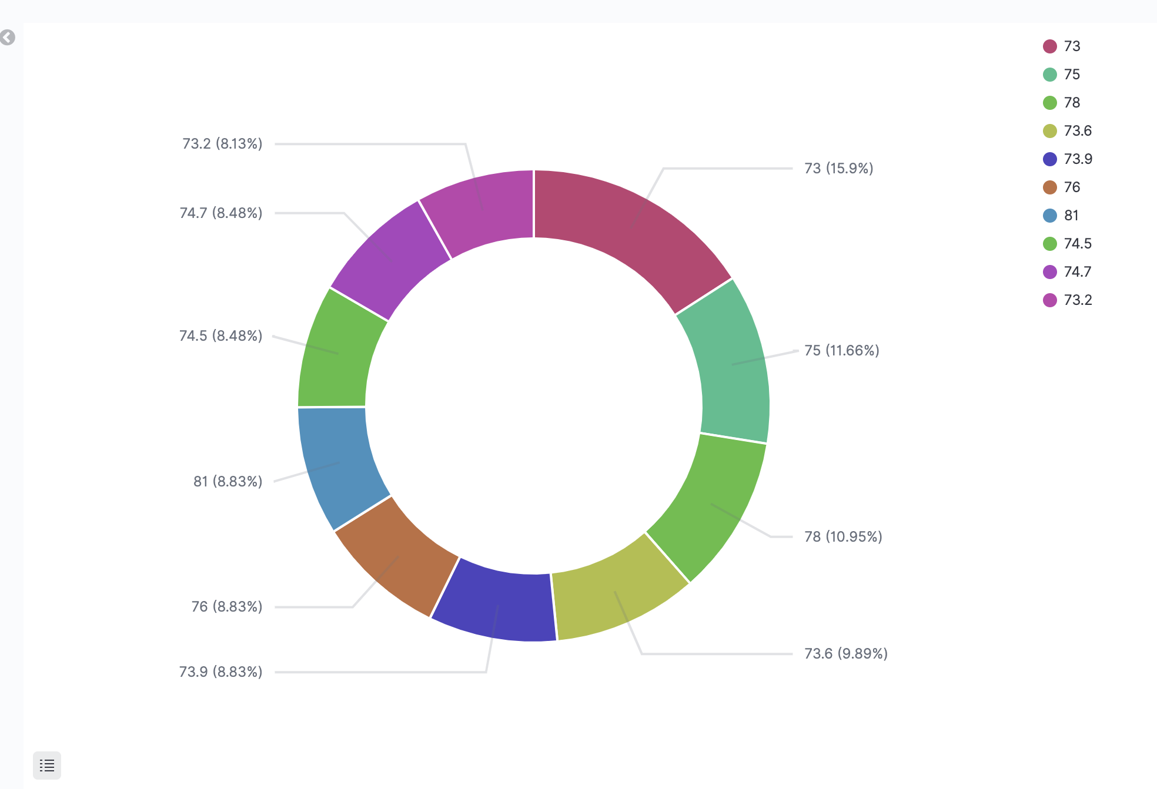
Result of life expectancy predicted

Slide 7
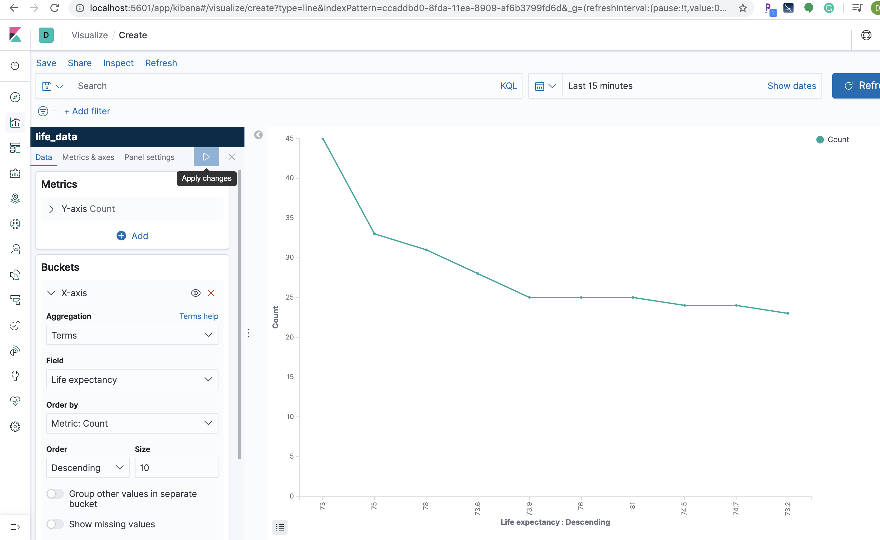

Slide 8
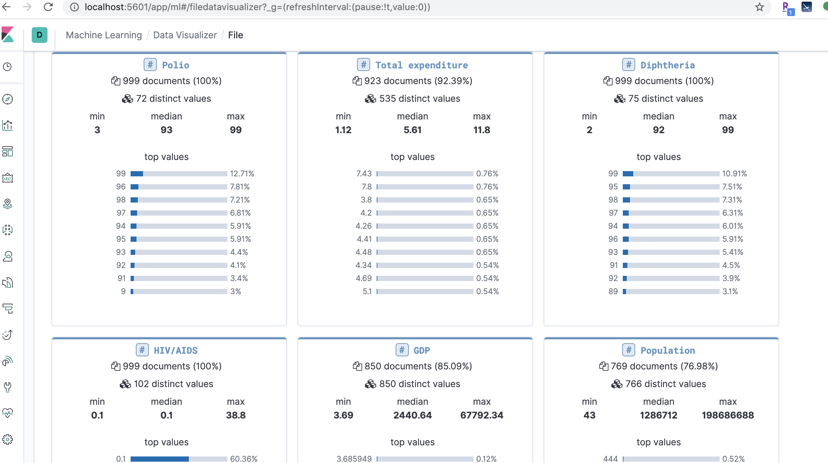

Slide 9
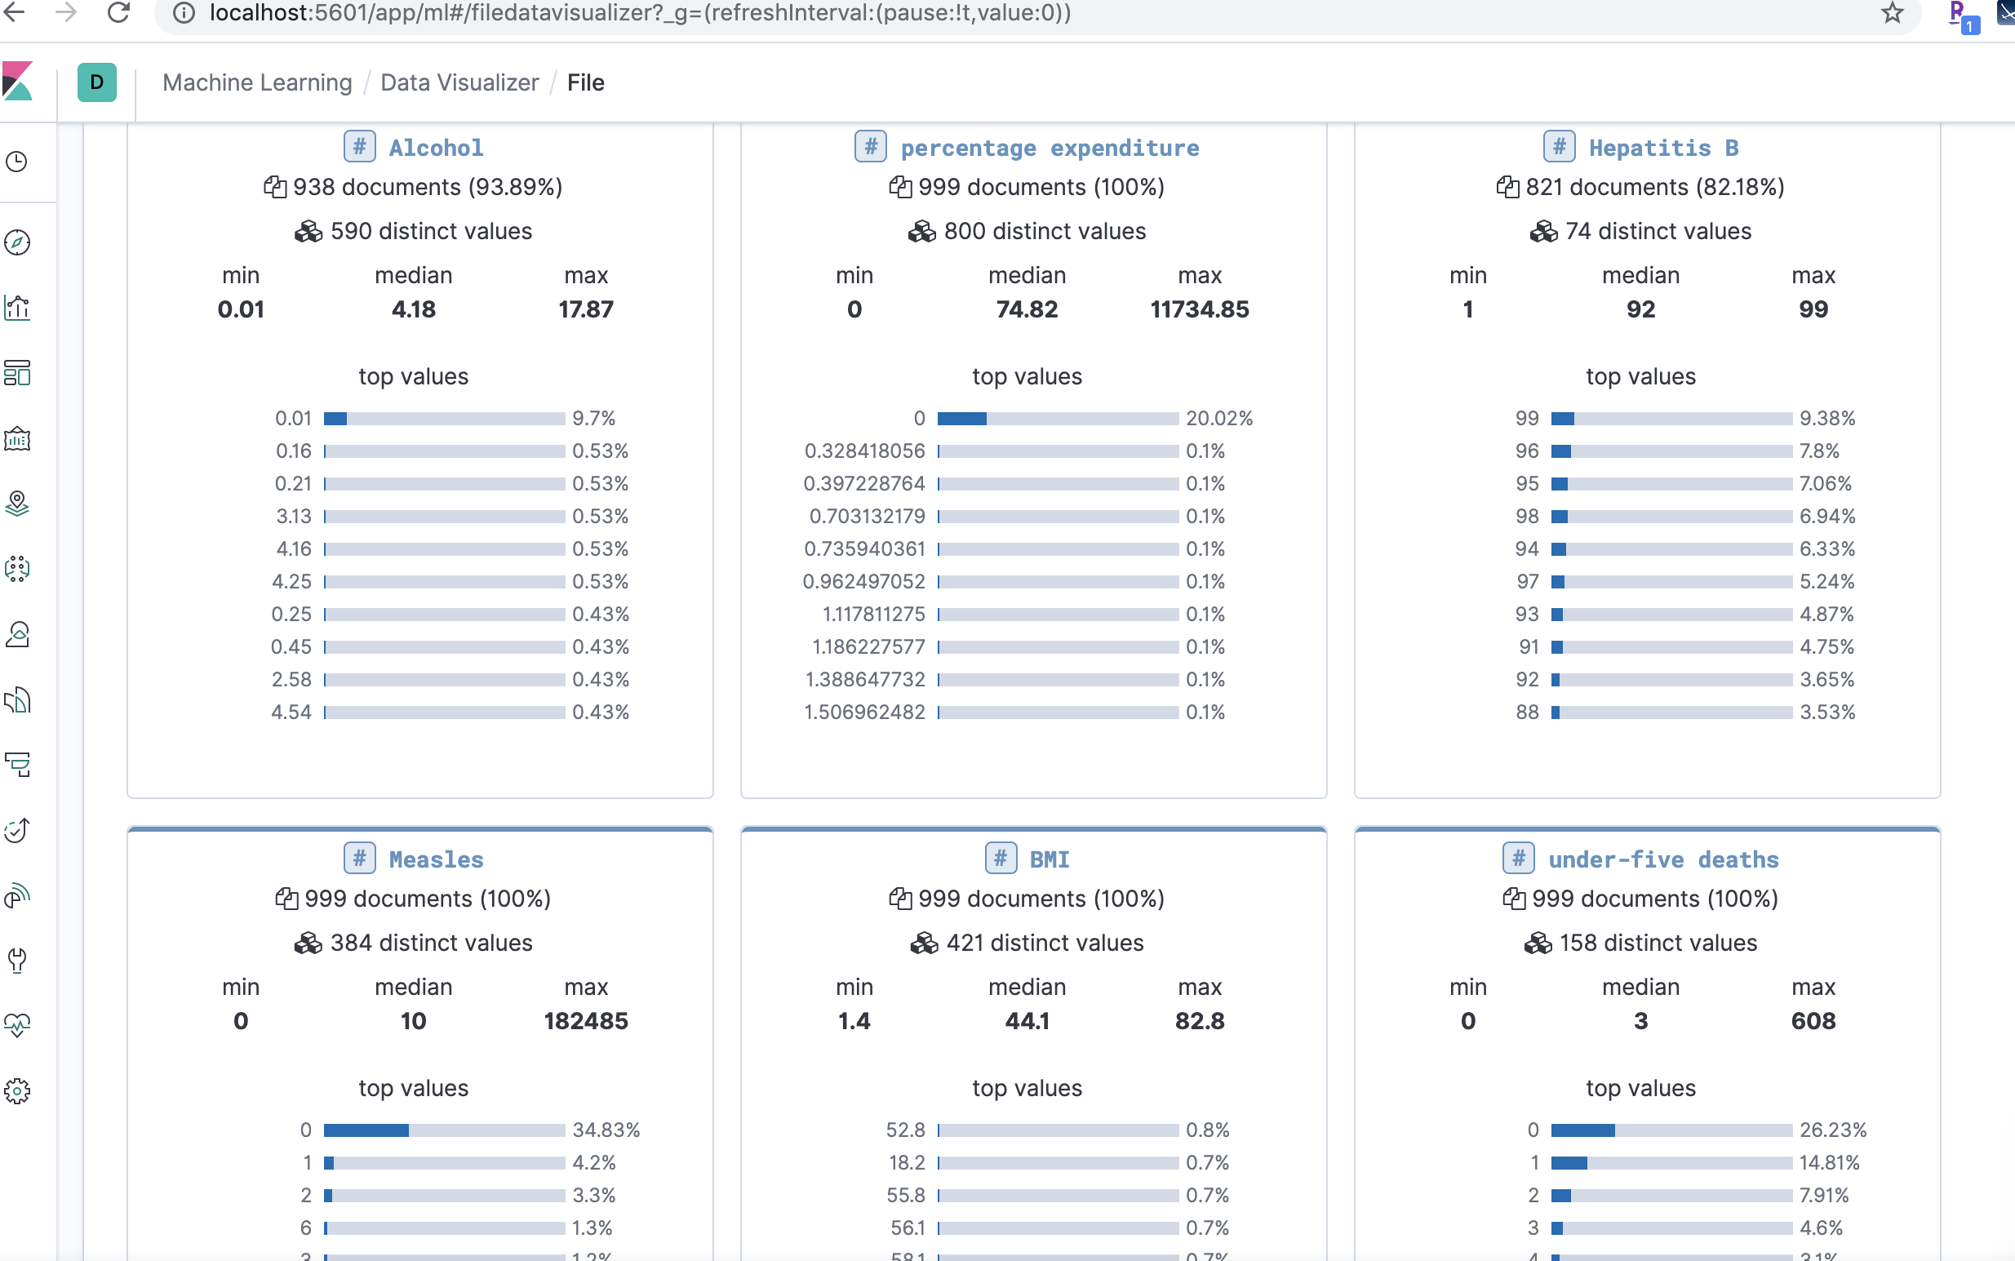

Slide 12
Thankyou

